Slide 1
Impact of Gender on Educational Outcomes at Secondary and Higher Education level in the UK
Adelaide Baron, Claire Evans, & Sian Steen
S

Slide 2

Project Aim
Working in partnership with a charity who wishes to assess the impact of gender on educational outcomes.
What outcomes are being achieved by females at secondary and higher education levels and how does this differ from outcomes for males?
Is there an increase in the number of females studying computer science-based subjects and in females entering the technology industry?
Is there a link between geographical location and the educational outcomes for females?
S
Notes:
Our group is working in partnership with a charity organisation who wishes to assess the impact of gender on educational outcomes. The organisation is working to improve access and opportunities for females in the UK. In particular, they are looking to increase the number of females entering the technology industry, which has previously been male dominated.

Slide 3
Group Approach
Agile working
Scrum master
Stand ups
Sprints
Separated areas of focus:
Secondary data – Claire
Higher Education – Sian
APIs and geography – Adelaide
A

Slide 4








A

Slide 5
Data Sources
Higher Education Statistics Agency (HESA) data – open data sets available
used to inform funding allocations for higher education providers and in other publications, such as league tables.
Data available for student enrolment and graduate outcomes
APIs
UniDB API – University & Degree demographics
Open Weather API – used for finding location & mapping
Gov.uk
16 – 18 Destinations
C

Slide 6
Restrictions
England only
Female or Male
Data cleansing
API data
No detailed documentation
Unknown accepted Universities & degrees
'None' results
C
Notes:
API:
- no detailed documentation on the universities in the database
- so we had to create methods to test against a list of universities to see which brought back valid results
- similarly for degrees
- this caused an unfortunate restriction on the degrees and universities analysed, and is not the most representative
- additionally, we had to perform data cleansing
- some of the successful unis or degrees still brought back 'none' as the result for the data we required, so we performed data cleansing using pandas and manually created methods

Slide 7
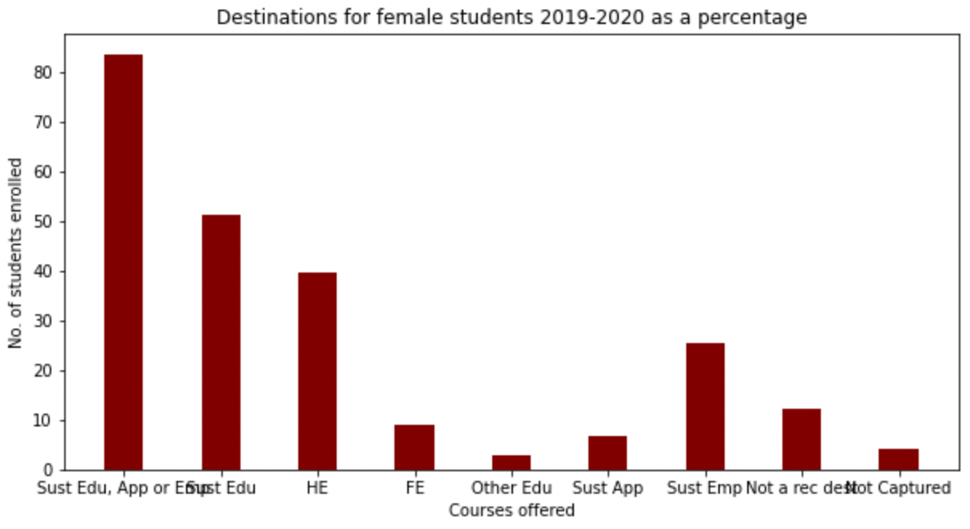
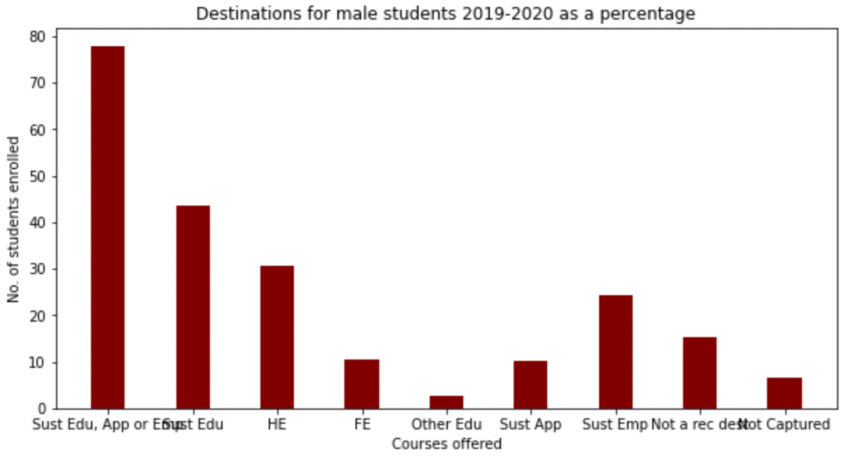
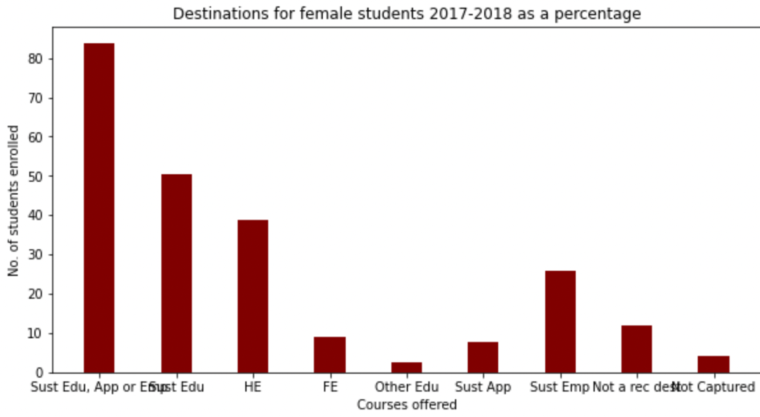
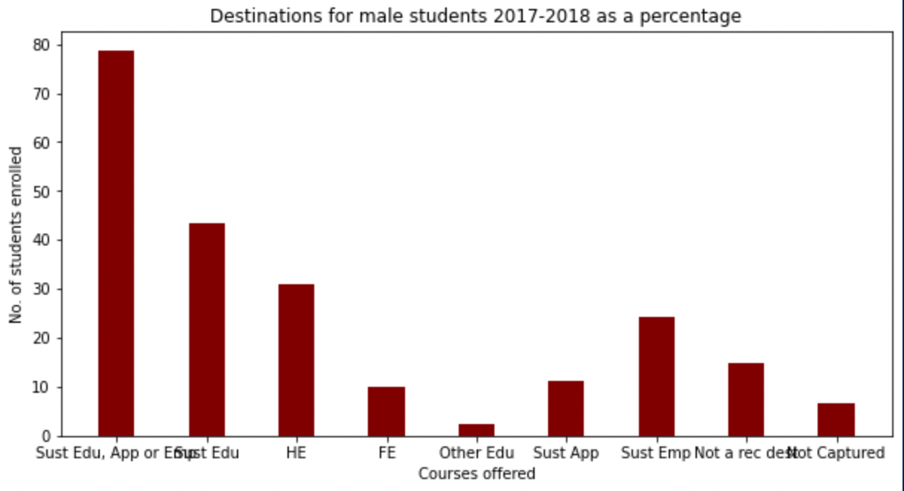
Destinations after KS5
2019/20
Most students progress into Sustained Education
Pattern remains constant over time
Gender doesn't appear to influence destination
2017/18
C

Slide 8
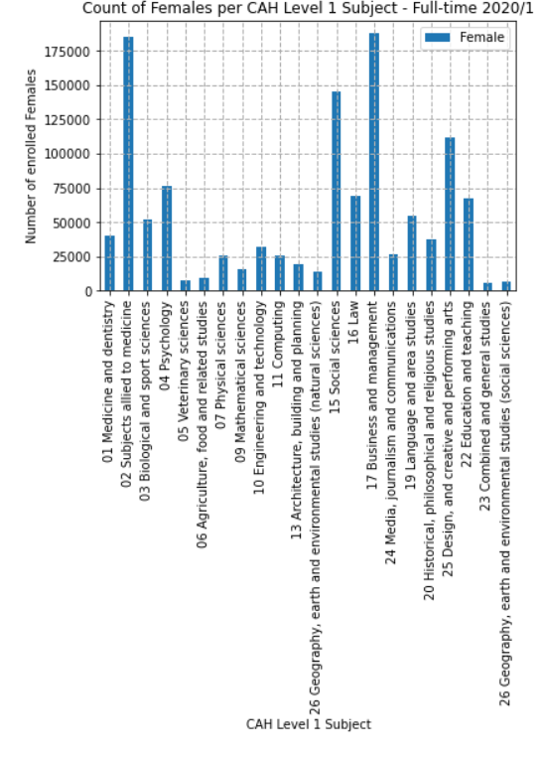
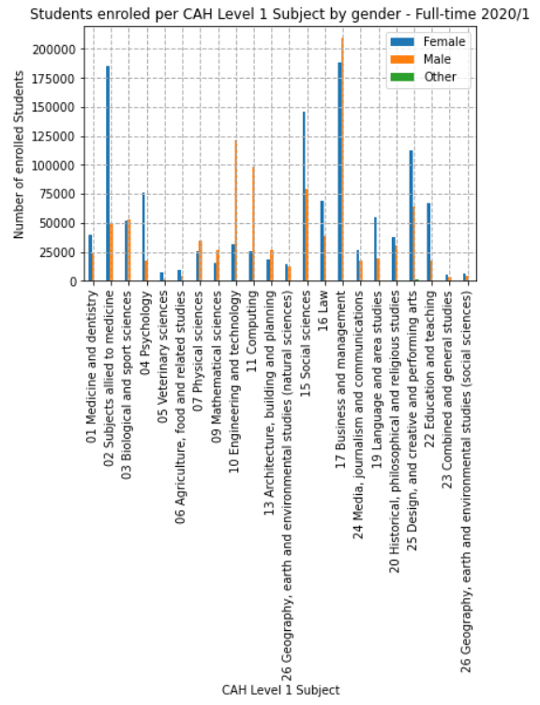
Enrolment by Subject Area
Cah - common aggregation category
Females are studying subjects predominantly in Subjects allied to medicine and Business and management
More males studying subjects in Engineering and technology and computing.
S
Notes:
The percentage of female students as a percentage of all students was 55.18% in 2014/5. The percentage of female students as a percentage of all students was 56.28% in 2020/1. This is only an increase of 1.06% in 7 years.
The percentage change in the number of female students from 2014/5 to 2020/1 is +34.16%.
* Common Aggregation Category
For first year enrolments at Higher Education providers in 2020/1, the highest number of female students enrolled on courses assigned to the CAH subject ‘17- Business and management’, closely followed by ’02- Subjects allied to medicine’. The most popular subject area for male students that year was also ‘17- Business and management’, but there is then a considerable drop in numbers to the second most popular subject, ’10 - Engineering and technology’. The least popular subjects for female students were ’23 – Combined and general studies’, ’26 - Geography, earth and environmental studies (social sciences) and ’05 – Veterinary sciences’.
In science-related subjects, more male students are enrolled on courses in subject areas ‘’10 - Engineering and technology’ and ’11 – Computing’, however, female enrolments are considerably higher in ’02- Subjects allied to medicine’ and higher than males for courses in ’01 – Medicine and dentistry’.
A similar pattern can be seen in the subject enrolment for part-time students.

Slide 9
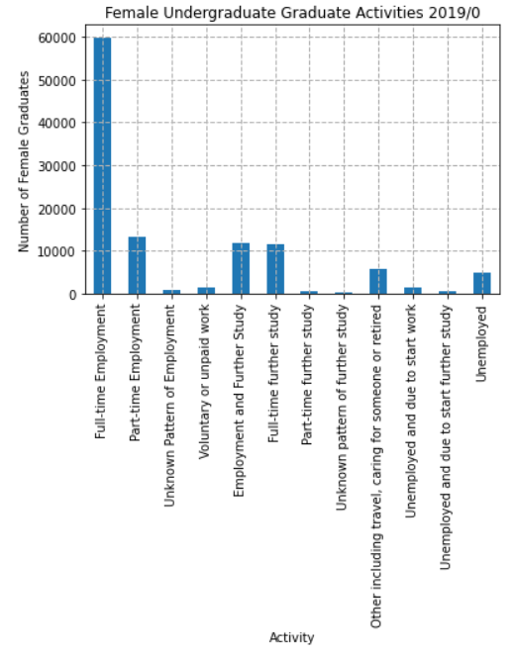
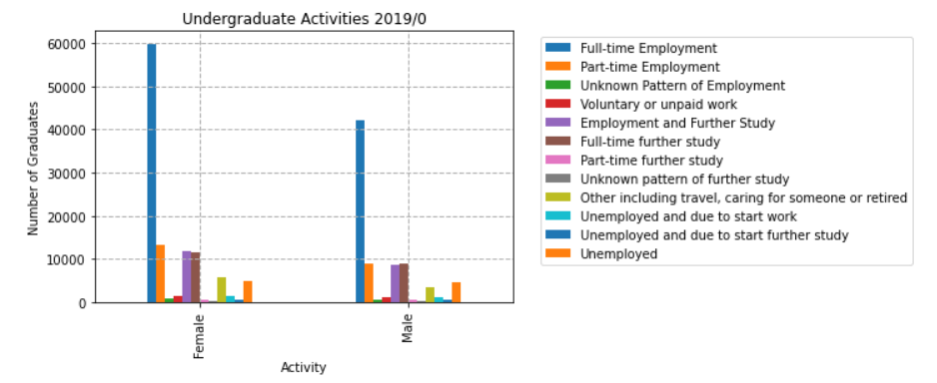
Graduate Outcomes
S
Notes:
59935 female undergraduate graduates were in full-time employment 6 months after completing their courses. This is in comparison to 42040 males going into full-time employment. A higher number of females than males were also in employment or further study, full-time further study and part-time further study.

Slide 10
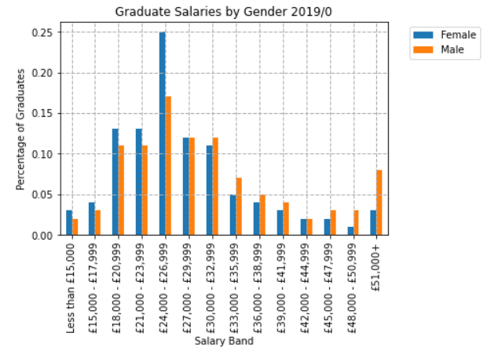
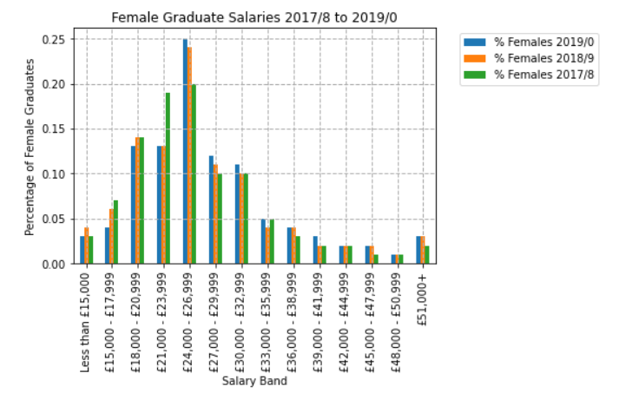
Graduate Salaries
S
Notes:
There have not been any significant changes in the salaries female graduates are earning from 2017/8 to 2019/0. There have been increases in the number of females earning the salary bands of £15,000 - £17,999 and £21,000 - £23,999.
For salary bands of £24,000 - £26,999 upwards, numbers have either remained consistent, or there has been a decrease in the number of female graduates earning higher salaries (such as , £51,000+, £45,000 - £47,999 and £36,000 - £38,999).

Slide 11
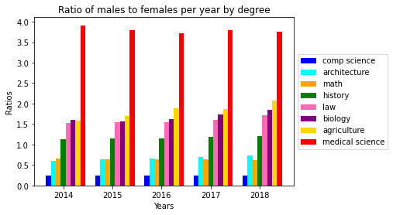
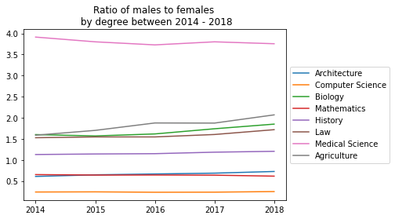
Gender split across degrees
A

Slide 12
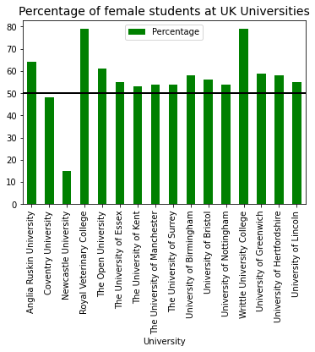
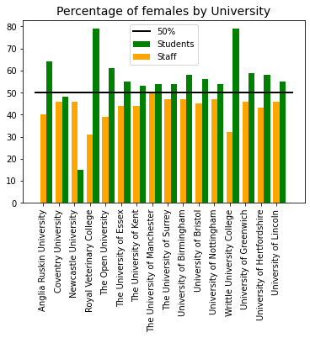
Females by University
A

Slide 13

A

Slide 14
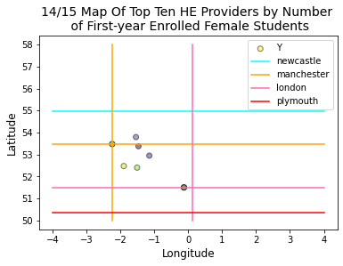
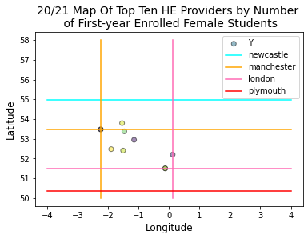
Location Top Ten Higher Education Providers by Number of First-year Enrolled Female Students
A

Slide 15
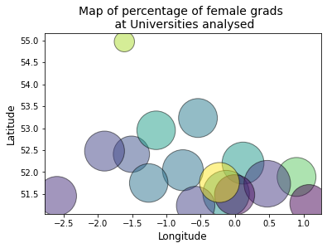
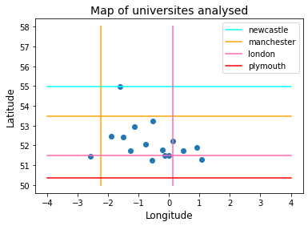
Location
API data
A

Slide 16
Conclusions
What outcomes are being achieved by females at secondary and higher education levels and how does this differ from outcomes for males?
Data for Secondary level pupils 2017/2018 is almost identical to 2019/2020.
At this stage in the education journey, gender appears to have zero impact on the destination.
Female students >50% the student population in England (56.28% in 2020/2021).
Numbers are increasing (percentage change in female student numbers from 2014/5 to 2020/1 is +34.16%).
Female UG graduates predominantly in full-time employment.
More female than male graduates in full, or part-time, employment or study.
Female graduates are earning less than male graduates.
Female salaries have not experienced significant change between 2017/2018 and 2019/2020.
C

Slide 17
Conclusions
Is there an increase in the number of females studying computer science-based subjects and in females entering the technology industry?
Less females studying ‘Engineering and technology’ and ’Computing’.
Female enrolments:
Considerably higher in ’Subjects allied to medicine’
Higher than males for courses in ’Medicine and dentistry’ 12
APIs - over a 4-year period:
Maths & computer science had more males than females.
Computer Science:
1:1 ratio reached within 288 years at the current growth rate.
S
Notes:
Is there an increase in the number of females studying computer science-based subjects and in females entering the technology industry?
Fewer female students studying subjects in the subject areas of ‘Engineering and technology’ and ’Computing’.
Female enrolments are considerably higher in ’Subjects allied to medicine’ and higher than males for courses in ’Medicine and dentistry’ 12
APIs - over a 4-year period, mathematics and computer science had more males than females.
Steady increase for computer science - 1:1 ratio reached within 288 years at the current growth rate.

Slide 18
Conclusions
Is there a link between geographical location and the educational outcomes for females?
Appears that universities around London have more females than males
Lowest female population is in Newcastle.
Locations for HE are not student domicile.
Further analysis required.
A
Notes:
- not enough data
- top 10 providers between manchester & london
- API data shows not a good coverage

Slide 19
Recommendations
Promote science & tech in secondary schools
Encourage/support female pupils to apply for science-based programmes
Work experience and to drive sponsored places on degrees.
Encourage female graduates to apply for:
Tech/academic sector
Higher salaries
Work with companies to identify and create opportunities for females to enter the technology sector.
C
Notes:
Target promotion of computing and science-based subjects to secondary level pupils
Increase support and initiatives to encourage female pupils to apply for science-based programmes, working with companies to promote work experience and to drive sponsored places on degrees.
Encourage and support female graduates to apply for jobs in the technology sector and for roles with higher salaries.
Work with companies to identify and create opportunities for females to enter the technology sector.

Slide 20
Future Studies
Consider other variables i.e., widening participation
Expand geographically
Access further datasets to conduct time series analysis and linear regression to make predictions.
A
Notes:
- explore not just England
- also ensure have a good spread over the uk

